Slide 1
Themes
Serious games – some knowledge transfer happens explicitly.
Board or virtual Narratives 1. Wolf amongst us. 2. History 3. Mythology Puzzles 1. http://www.metacritic.com/browse/games/genre/date/puzzle/pc

Slide 2
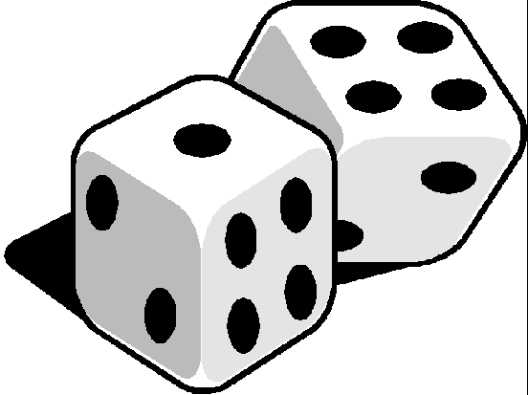
Mechanic 5 – Skill Introducing Complexity
From game to Player

Slide 3
Complexity: Games as emergent systems
If complexity is not present in a game, meaningful play cannot occur.
Meaningful play and complexity are not the same thing: they refer to different aspects of games. But complexity is a necessary prerequisite of meaningful play.
According to physicist Per Bak, a complex system can't be too orderly, where the system has the same behavior from moment to moment. At the same time, a system can't be completely chaotic, where each moment of the system's operation only randomly corresponds to the next moment.

Slide 4
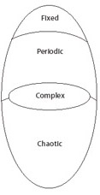
System of complexity Christopher Langton, pioneering mathematician of artificial life
Fixed: unchanging
Periodic: repetitive
Chaotic: elements in motion, states & relationship are random.
Complex: more complicated and unpredictable than a periodic system, but not so full of dynamic relationships that they end up as a chaotic.

Slide 5
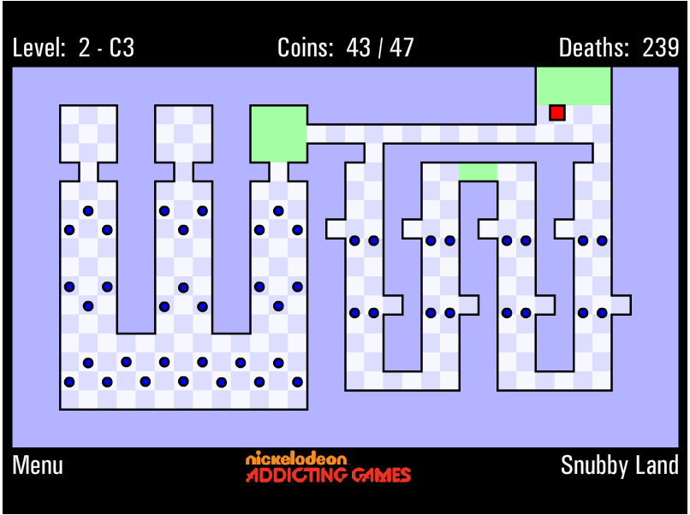
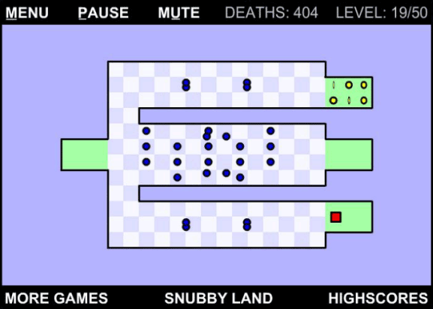
Examples – systems of interaction
https://www.youtube.com/watch?v=pCtF9YSUaek

Slide 6
Making a game into a complex system
Example:
Head or Tails: One player flips a penny out of sight of the other player. The other player guesses whether or not the penny landed on heads or tails. If the guesser is correct, the guesser wins. Otherwise, the player that flipped the penny wins.
Question: Is this complex?
Heads and Tails: The Decision Variant. Instead of randomly flipping the penny, the flipper gets to decide which side is facing up. The other player guesses which side the flipper selected. If the guesser is correct, the guesser wins. Otherwise, the player that flipped the penny wins.

Slide 7
Meaningful Play
Meaningful play in a game emerges from the relationship between player action and system outcome; it is the process by which a player takes action within the designed system of a game and the system responds to the action. The meaning of an action resides in the relationship between action and outcome.
So in the heads or tails game, the outcome is not controlled by the player at all and hence not a meaningful play – agree?
Meaningful play is not complexity , as the former concerns the relationship between decision & outcome and the later defines the way the parts relate to each other in a system – BUT complexity is a prerequisite of meaningful play.
This phenomenon of systems generating complex and unpredictable patterns of behavior from simple rules-is called emergence.

Slide 8
Emergence Jeremy Campbell - Grammatical Man
Emergence is a crucial facet of understanding how the system of a game becomes meaningful for players.
Key features of emergence: a simple set of rules applied to a limited set of objects in a system leads to unpredictable results.
Hence, Emergence can come about through complex programmed mechanisms that simulate adaptive agents and systems but it can also happen when extremely simple rules give rise to complex social or psychological relationships among players.

Slide 9
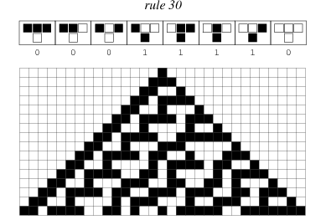
Complexity – example: Cellular Automata (John Von Neumann and Stanislaw Ulam in the 1930s and 1940s.)
The simplest type of cellular automaton is a binary, nearest-neighbor, one-dimensional automaton. Such automata were called "elementary cellular automata" by S. Wolfram.
The rules govern the behavior of the cells.

Slide 10
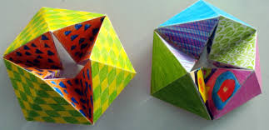
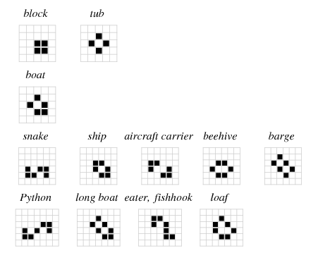
The game of LIFE – NOT really a game though! John H. Conway and popularized in Martin Gardner's Scientific American column (1970)
http://www.bitstorm.org/gameoflife/

Slide 11
Emergence: example of Life Langton, Artificial Life
Coupled :The interaction between any two objects is not an isolated relationship.
Whether or not a cell is alive or dead in Life is dependent on the positions of the adjacent cells; the life and death of those cells are also dependent on all of their adjacent cells
Context-dependent: as the context of an object in a system changes, its relationships to other objects change. In the case of Life, the context of any given cell is its eight neighbors.

Slide 12
Complexity/emergence from Game story
ludologists vs. narratologists,
(study of games and game play)

Slide 13
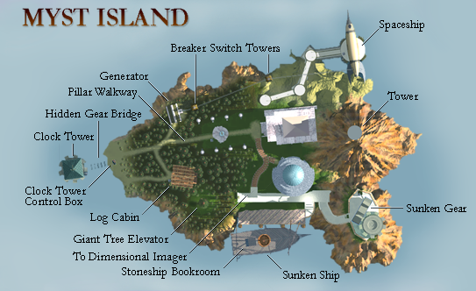
Methods for story in games - linear
The string of pearls or rivers & lakes
Each is world!
September 24, 1993
Mac, Windows, Saturn, PlayStation, Jaguar CD, Amiga OS, CD-i, 3DO, PSP (Re-release), Nintendo DS (Re-release)
Myst was originally based upon an unpublished story written by one of the Miller brothers called Dunny Hut. The newer version has a non-linear story though
Nudges the player in a direction

Slide 14
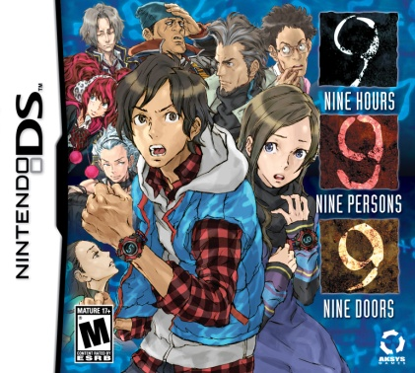
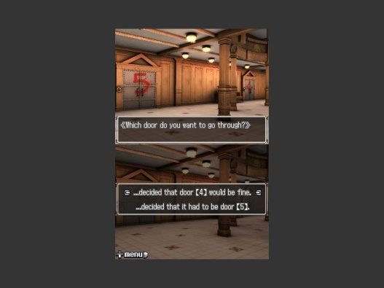
Methods for story in games : non-linear - branching
Provides the player with choice of path.
Nine people have been abducted by a mysterious kidnapped and are on a ship
They are told that they have nine hours to escape before the ship sinks beneath the waves.
There is a AI character ‘Zero’ who supplies puzzles to solve & unlock the doors.
The group is forced to split up into various subgroups and explore "numbered doors," .
Escape lies behind a door numbered 9.
A cooperative game where the characters must work together despite suspicions of each other to advance.
Zero Escape: Nine Hours, Nine Persons, Nine Doors
Gives player the chance to choose a direction

Slide 15
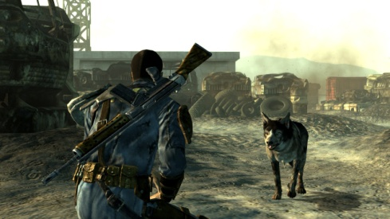
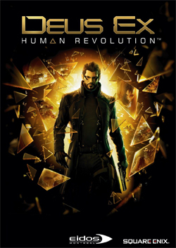
Non-linear
Fallout 3
combines FPS, stealth and RPS — developed by Ion Storm and published by Eidos Interactive in 2000.
multiple narrative paths
Society spiraling to chaos
Divide between rich & poor
A lethal pandemic
A antibiotic in short supply
Riots & terrorists
And a powerful UN organization
Game play:
Player is an UN agent who can track different roles
to track terrorists outfits smuggling the antibiotic

Slide 16
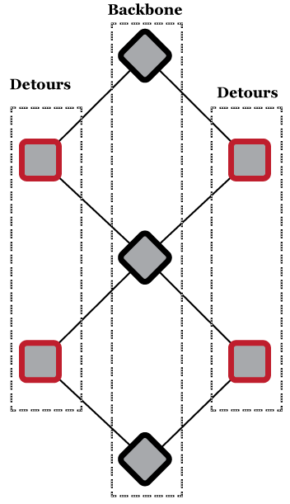
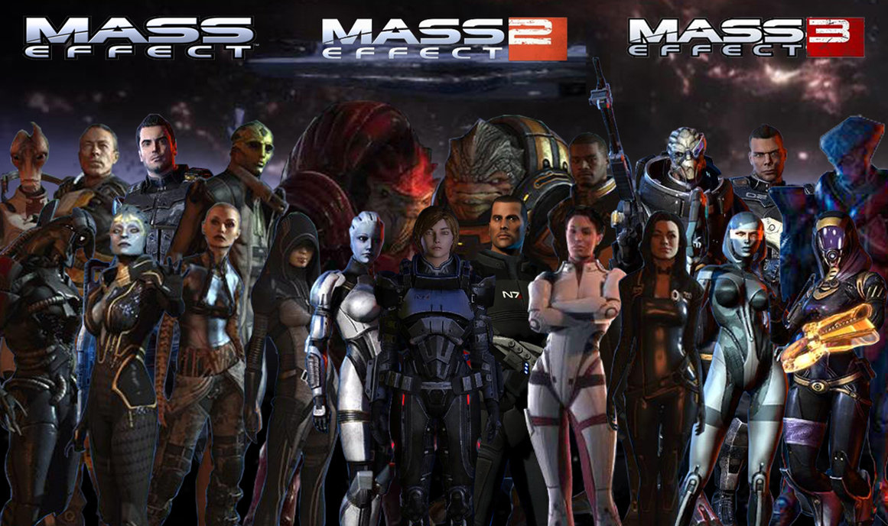
Detour Narrative or combinatorial
Guides the player back to the main plot or goal
Also categorized as Parallel path story style

Slide 17
Other types of Game stories
parallel plot structure
nodal, or dead-end structure
modulated, or the dynamic labyrinth structure.
an open structure in which sets of story elements are associated with different physical places; links between places are open
an open structure in which there is no story arc (examples: simulation type of games, MMORPGs)

Slide 18
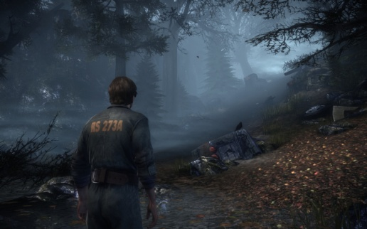

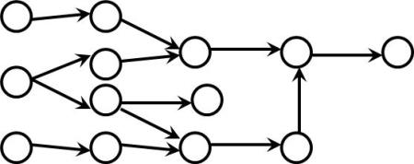
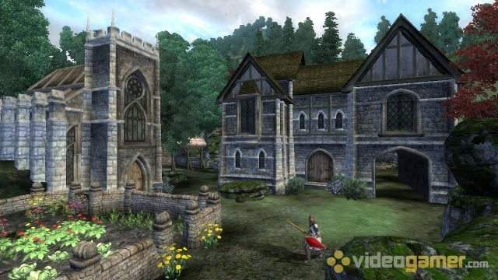
Mandatory conditions
Silent Hill
Parallel
Threaded
Oblivion
Programming choices?

Slide 19

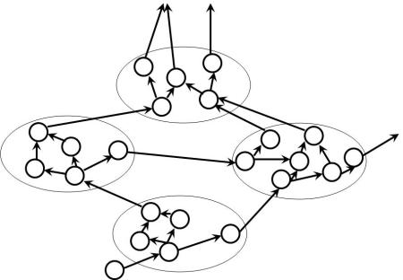
Facade
Dynamic Object-Oriented Narrative

Slide 20
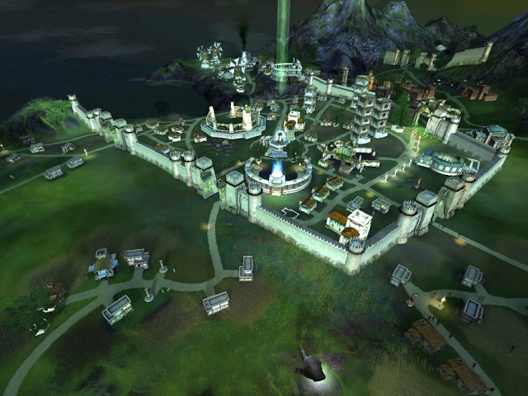
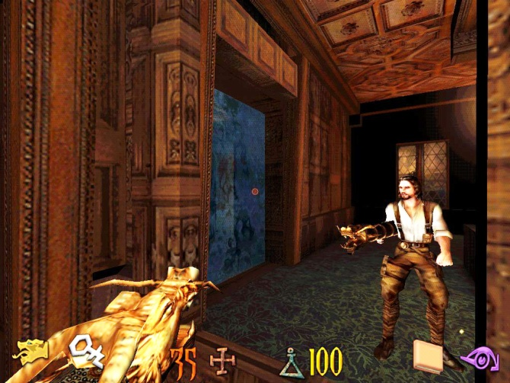
Flashback in games
Black & White
Undying
A bit of deeds before shaping the avatar!

Slide 21
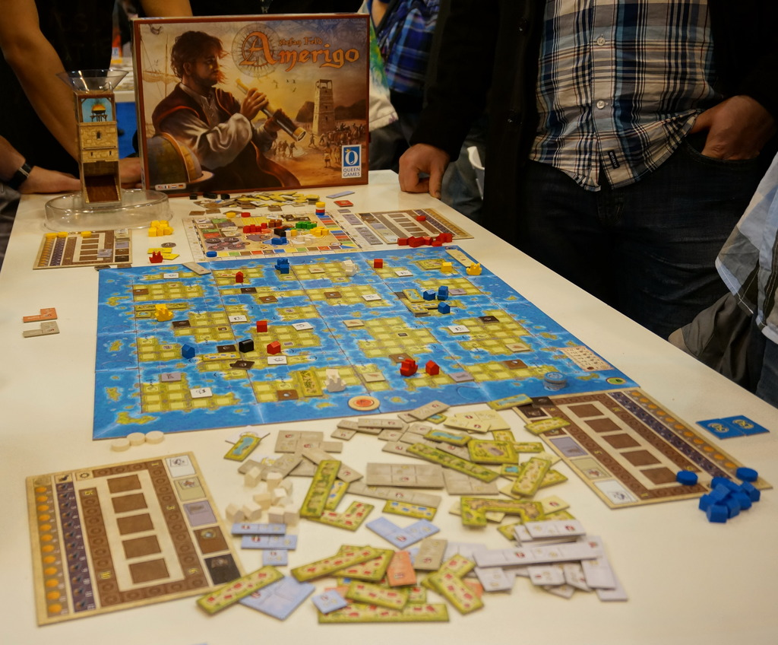
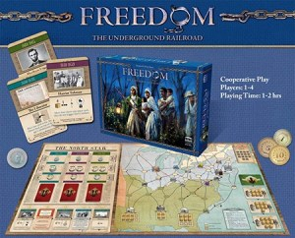

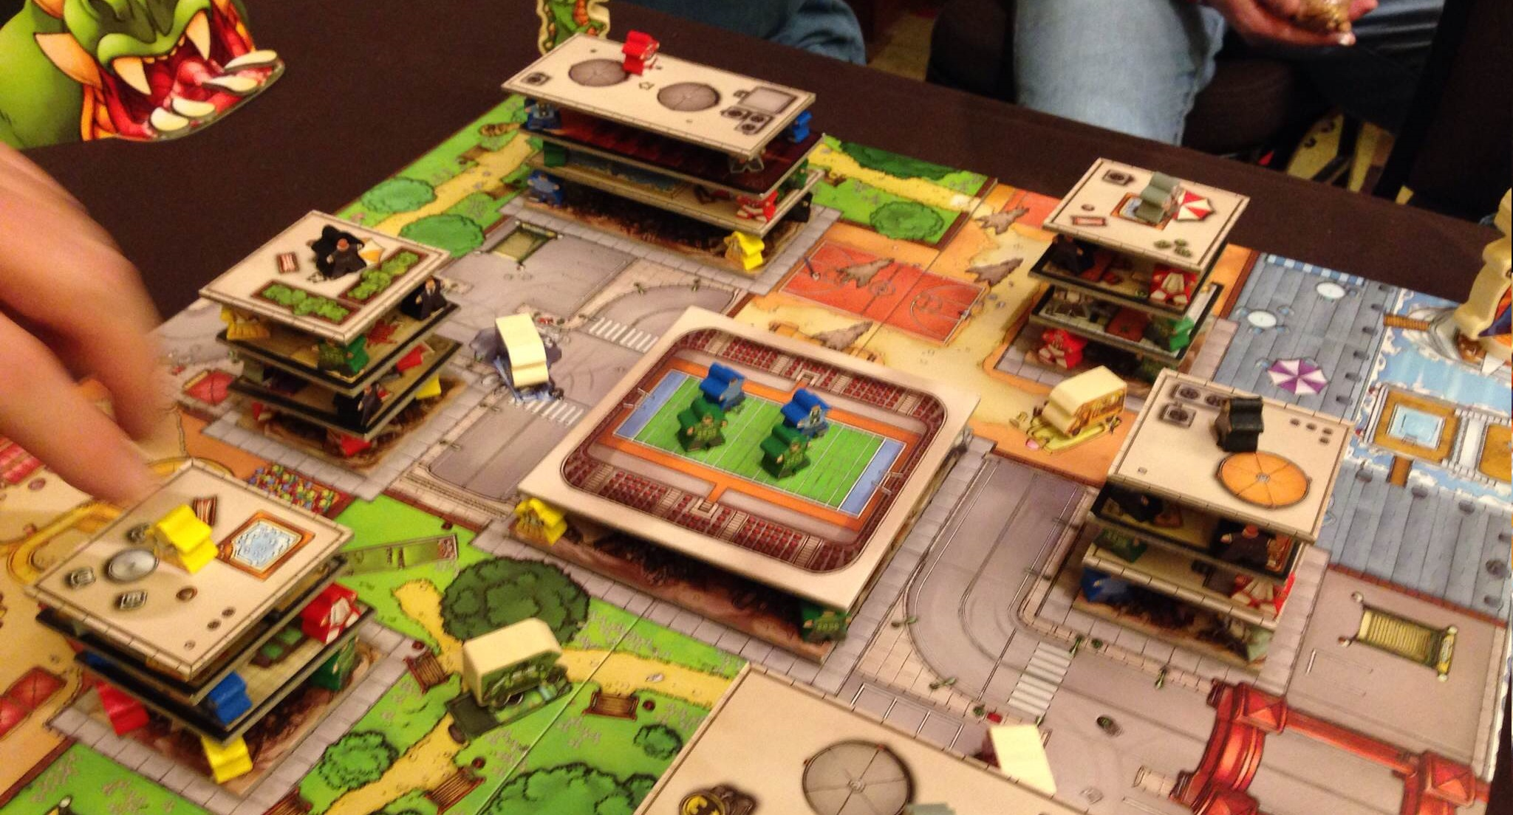
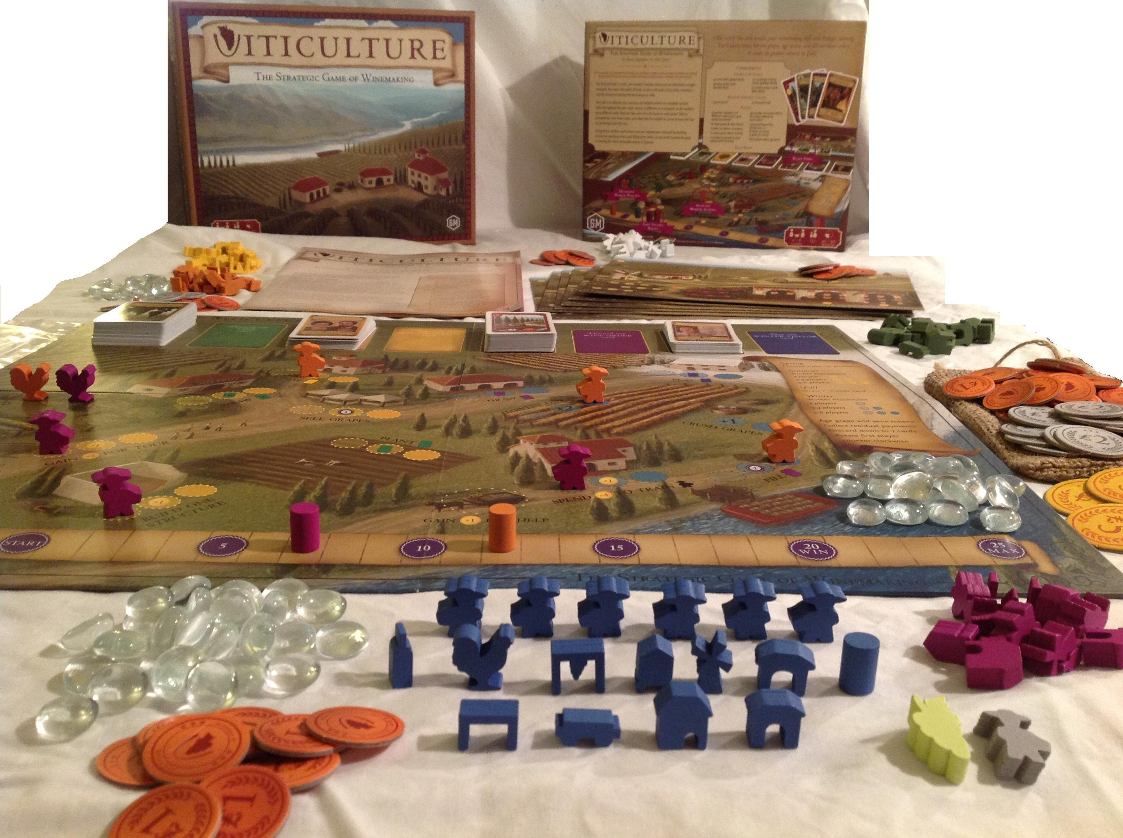
Story – in Board games Best of 2013
Amerigo
Sails of Glory- Napolean wars
VITICULTURE
Rampage

Slide 22
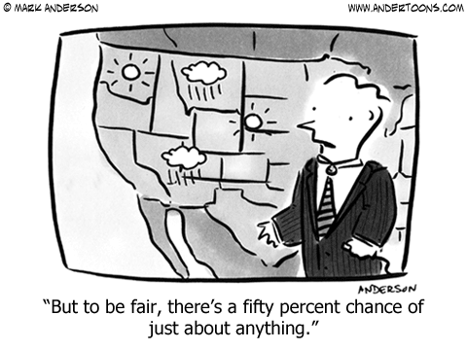
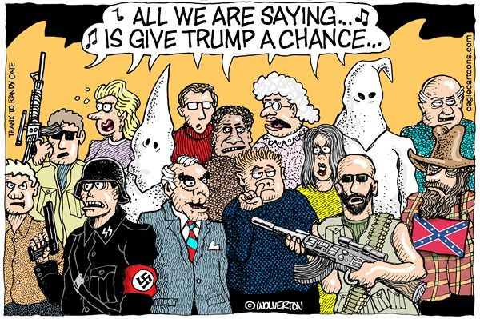
Chance
In The Doctrine of Chances Peirce in effect states that anything that can happen will happen;
!! thus insurance companies must eventually fall bankrupt.

Slide 23
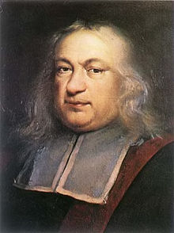
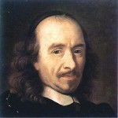
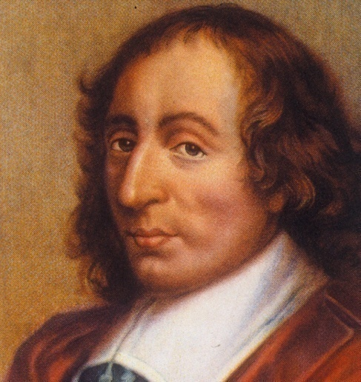
Mechanic 6: Chance
What does ‘chance’ bring to a game?
The birth of probability – story of Gombauld/Pascal/Fermat
Gombauld
Pascal
Pierre de Fermat

Slide 24
Gombauld (1654)
Rolled one dice 4 times. Bet that at least (one-time) there will be a six.
Won a lot of bets – but put people off!!.
4 * (1/6) = 4/6 or 66%
So, he said 2 dice thrown 24 times, at least one 12 will fall.
His math: 24 * 1/36 = 24/36 = 2/3 = 66%
He started loosing!
Why? What was the mistake he made?

Slide 25
10 rules of probability for every game designer
Rule 1# Fractions are decimals are percents
Rule 2# Zero to one
Consider Gombauld’s problem
for 4 dice to get a 6 this chance was 66%, suppose he had 8 then it would be 113%!!!
Rule 3# “looked for” divided by “Possible Outcomes” Equals Probability
Notes:
Rule 2# more chances does not mean increased chance of winning.

Slide 26
Chance - Rules
Rule # 4: Enumerate
- flip a coin 3 times and find out the odds of getting at least ‘heads’ twice.
Rule # 5: In certain Cases, OR Means Add
- mutually Exclusive : face card or ace – 12/52 and 4/52
- Not Mutually exclusive : ace or a diamond
Rule # 6: In certain cases, AND means multiply
- the chance of getting 2 sixes in 2 dice is 1/6 * 1/6 = 1/36

Slide 27
Chance - Rules
Rule #7 : One minus “does “= “Doesn’t”
Rule #8: The sum of Multiple linear random selections is NOT a linear random selection.
Rule # 9: Roll the Dice
- Monte Carlo method
Rule # 10 : Geeks love showing off (Gombauld’s law)

Slide 28
What are the chances of rolling four dice, and getting either:
a. Four sixes, OR ➔ 1/1296
b. Three sixes and one non-six, OR (6,6,6,non-six;6 6 non-six,6;…)
1/6*1/6*1/6*5/6 = 5/1296 *4 = 20/1296;
c. Two sixes and two non-sixes, OR (1/6*1/6*5/6*5/6) = 25/1296 * 6 = 159/1296;
d. One six and three non-sixes: 500/1296;
Adding: 671/1296 which is 51.77%;

Slide 29
The Chevalier’s puzzle explained
Solution to Problem 1
Four rolls of a dice may have one of 6⁴ equi-probable outcomes. Of these, 5⁴ are unfavorable leaving (6⁴ - 5⁴) favorable for the bet. The probability of getting at least 1 ace is then
(6⁴ - 5⁴) / 6⁴= (1296 - 625) / 1296 = 671 / 1296 ≈ 0.5177 ... > 0.5 showing that the odds are in favor of the better.
Solution to Problem 2
One double roll has 36 equiprobable out comes of which 35 are unfavorable to the bet. In 24 rolls there are 36²⁴ possible outcomes of which only (36²⁴ - 35²⁴) are favorable. Thus the probability of winning the bet equals
(36²⁴ - 35²⁴) / 36²⁴= 1 - (35/36)²⁴ ≈ 1 - 0.5086 = 0.4914 < 0.5.

Slide 30
Expected value
Action in a game is a value – positive or negative.
How can a game designer calculate this value?
Example: If on roll of two dice, a seven or a eleven fetches $5 and anything else results in loss of $1, what is the expected value of the game?
For 7 – chance is 6/36 and 11 is 2/36
Anything else = 1 – 8/36 or 28/36
Expected value:
7 : 6/36 * $5 = $0.83
11: 2/36* $5 = $0.28
Everything else: 28/36 * -$1 = -$0.78
Expected value : $0.33

Slide 31
How does expected value make for game play?
Decides if the design allows anyone to win in a game of chance.
Consider this: what is the expected value?
attack name | chance of hitting | damage
wind | 100% | 4
Fireball | 80% | 5
Lightening bolt | 20% | 40
What would a player use against an enemy? & how will you help the
Player Calculate the best option?

Slide 32
Human element expt by Daniel Kahneman and Tversky
A study result:
Game A: 66% chance of wining $2400,
33% chance of wining $2500
1% chance of wining $0
Game B: 100% chance of wining $2400
Expected values: 0.66 *2400 + 0.33 *2500 +0.01 * 0 = $2409
Game B: 1.00*2400 = 2400
Only 18% of the players played game A!!
Why? Regret?
Tversky puts it this way: “When it comes to taking risks for gains, people are conservative. They will make a sure gain over a problem gain. But we are also finding that when people are faced with a choice between a small, certain loss and a large, probable loss, they will gamble. ”

Slide 33
Other interesting examples
1) Monty Hall problem
http://www.mathwarehouse.com/monty-hall-simulation-online/.
2)The Two Envelopes Problem
You are playing a game for money. There are two envelopes on a table. You know that one contains $X and the other $2X, [but you do not know which envelope is which or what the number X is]. Initially you are allowed to pick one of the envelopes, to open it, and see that it contains $Y . You then have a choice: walk away with the $Y or return the envelope to the table and walk away with whatever is in the other envelope. What should you do?

Slide 34
Lens # 28: Lens of expected value & chance
What is the actual chance of a certain event occurring?
What is the perceived chance?
What value does the outcome of that event have?
What in my game is truly random? What parts just feel random?
Do players have the opportunity to take interesting risks in the game?

Slide 35
Skill and Chance Get Tangled
Estimating chance is a skill
Skills have a probability of success
Estimating an opponent’s skill is a skill
Predicting pure chance is an imagined skill- “lucky streak fallacy”; “gambler’s fallacy ”
Controlling pure chance is an imagined skill

Slide 36
Play the online version of Craps – http://www.randomservices.org/random/ Understand the ‘bets’. Look up and try playing the “The game of Treize”

